Slide 1
Employee Data Analysis using Excel
STUDENT NAME: V . KAVYA SREE
REGISTER NO: 122203931
DEPARTMENT: B com(corporate secreteriship)
COLLEGE: Shri Shankarlal Sundarbai Shasun Jain college for women

Slide 2
PROJECT TITLE
Employee Marital status Analysis using Excel

Slide 3


AGENDA
Problem Statement
Project Overview
End Users
Our Solution and Proposition
Dataset Description
Modelling Approach
Results and Discussion
Conclusion
3/21/2024 Annual Review

Slide 4

PROBLEM STATEMENT
Employee analysis is used to identify the marital status
Of an employee with the help of data analysis organization can achieve its goals .

Slide 5

PROJECT OVERVIEW
An employee marital status analysis summary can include information on an employee strengths, weaknesses, and area for improvement. It can also help identify an employees potential and how they can advance in career .

Slide 6




WHO ARE THE END USERS?

Slide 7

OUR SOLUTION AND ITS VALUE PROPOSITION
Conditional formatting - missing values highlighting
Filter - remove blank value
PIVOT - summary
Graph – data visualization

Slide 8
Dataset Description
Employee dataset - KAGGLE
Under 26 features included 9 features only namely
employee id
first name , last name
Business unit
Department type
Gender code
employee status
employee type
marital status

Slide 9

MODELLING
DATA COLLECTION :
we collect this data to analyze employee marital status and how the organization can identify the work environment and basic needs of the employees
DATA CLEANING :
After the collection of data we started to sort out what data is need for the project .
GRAPH VISUALISATION :
Through this graph we can easily able to know performance that has been done
3/21/2024 Annual Review
9

Slide 10
MODELLING
TABLE :
Table is a container for data that is organized in rows and columns . Table are a way to organize related data and make it easier to analyze and manage .
Table analysis :
with help of table , it is easy to analyze data which are organized in rows and columns . We filter the data and draw out the data needed for marital status analysis and then used POVIT table method to make the table simple and presentable to get easier understanding .
10

Slide 11
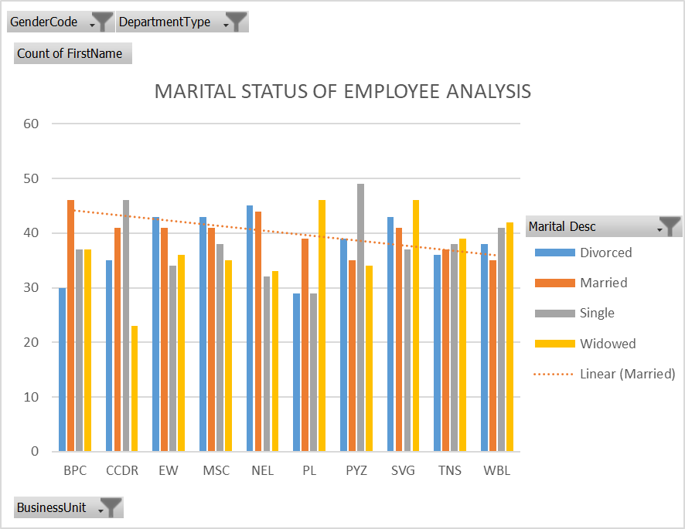
RESULTS
11

Slide 12
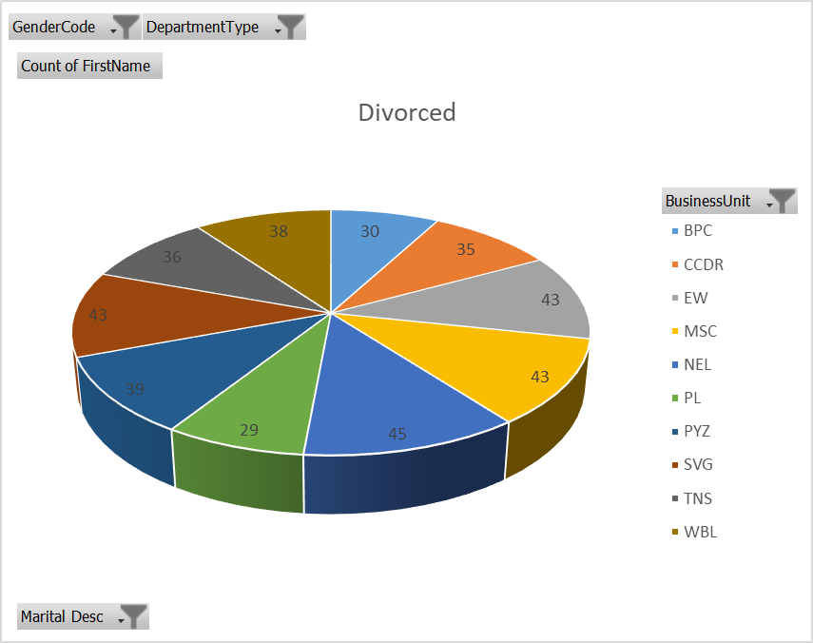
RESULT

Slide 13
conclusion
Employee data analysis is important in an organization and thus it help to achieve goals . Organization may considered offering benefits and programs that support employees work life balance and family responsibilities, such as flexible work arrangements . Organization can promote a more supportive and inclusive work environment , leading to increased employee engagement, retention, and overall well-being .

